Slide 1

Wielders
Adamo
Recordamur Studios

Slide 2
TABLE OF CONTENTS
02
03
04
05
06
Elevator Pitch
01
Unique Selling Points
Target Audience
Gameplay, Genre, Loops
Scope
Questions

Slide 3

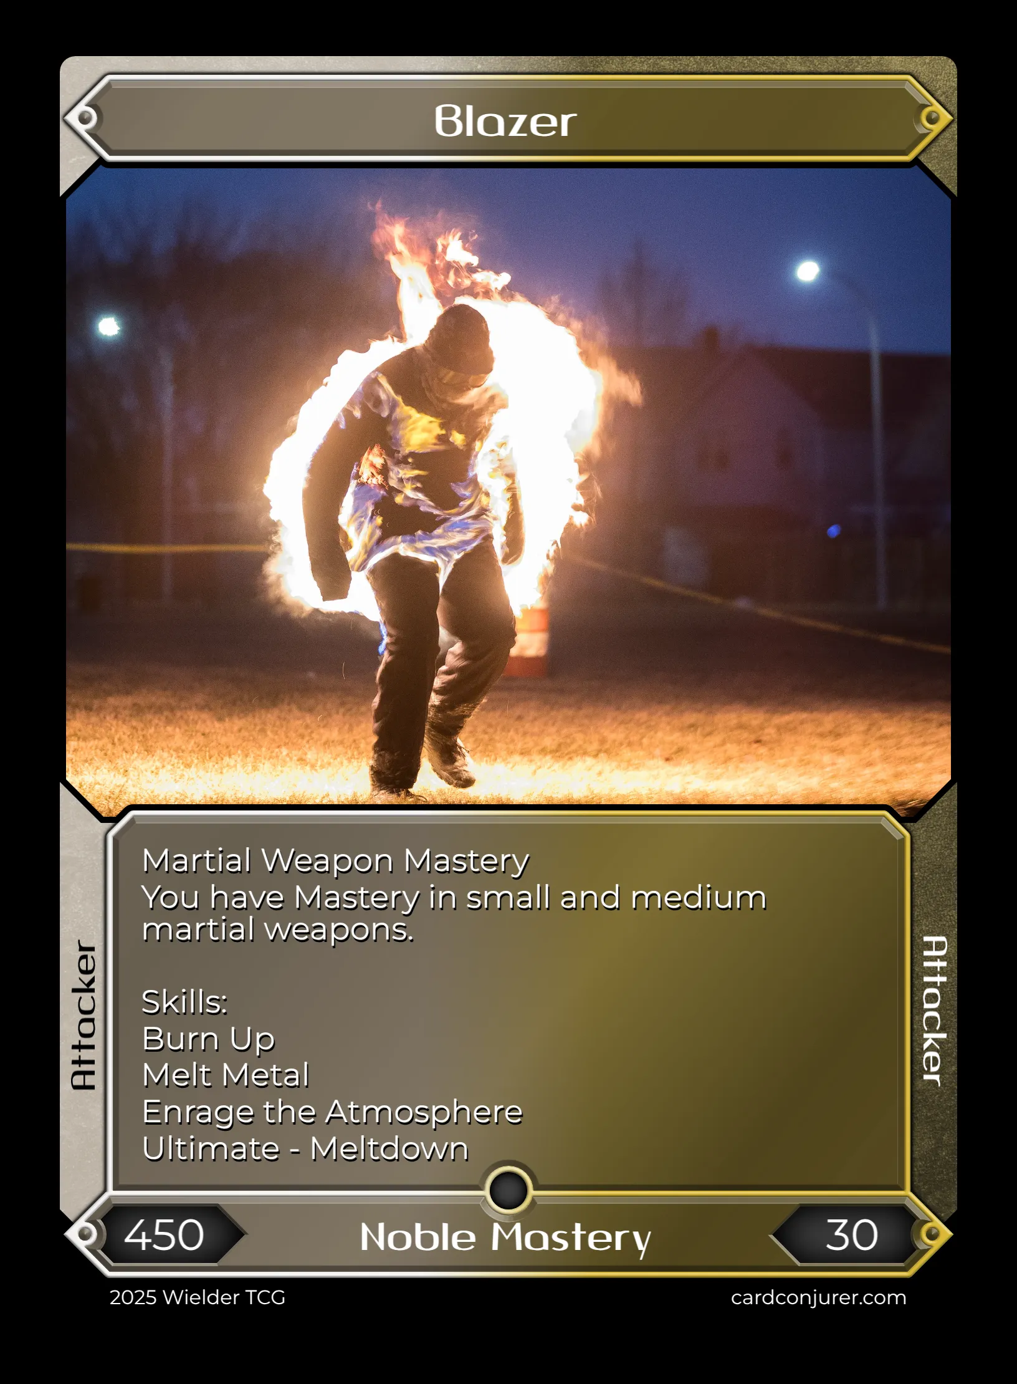
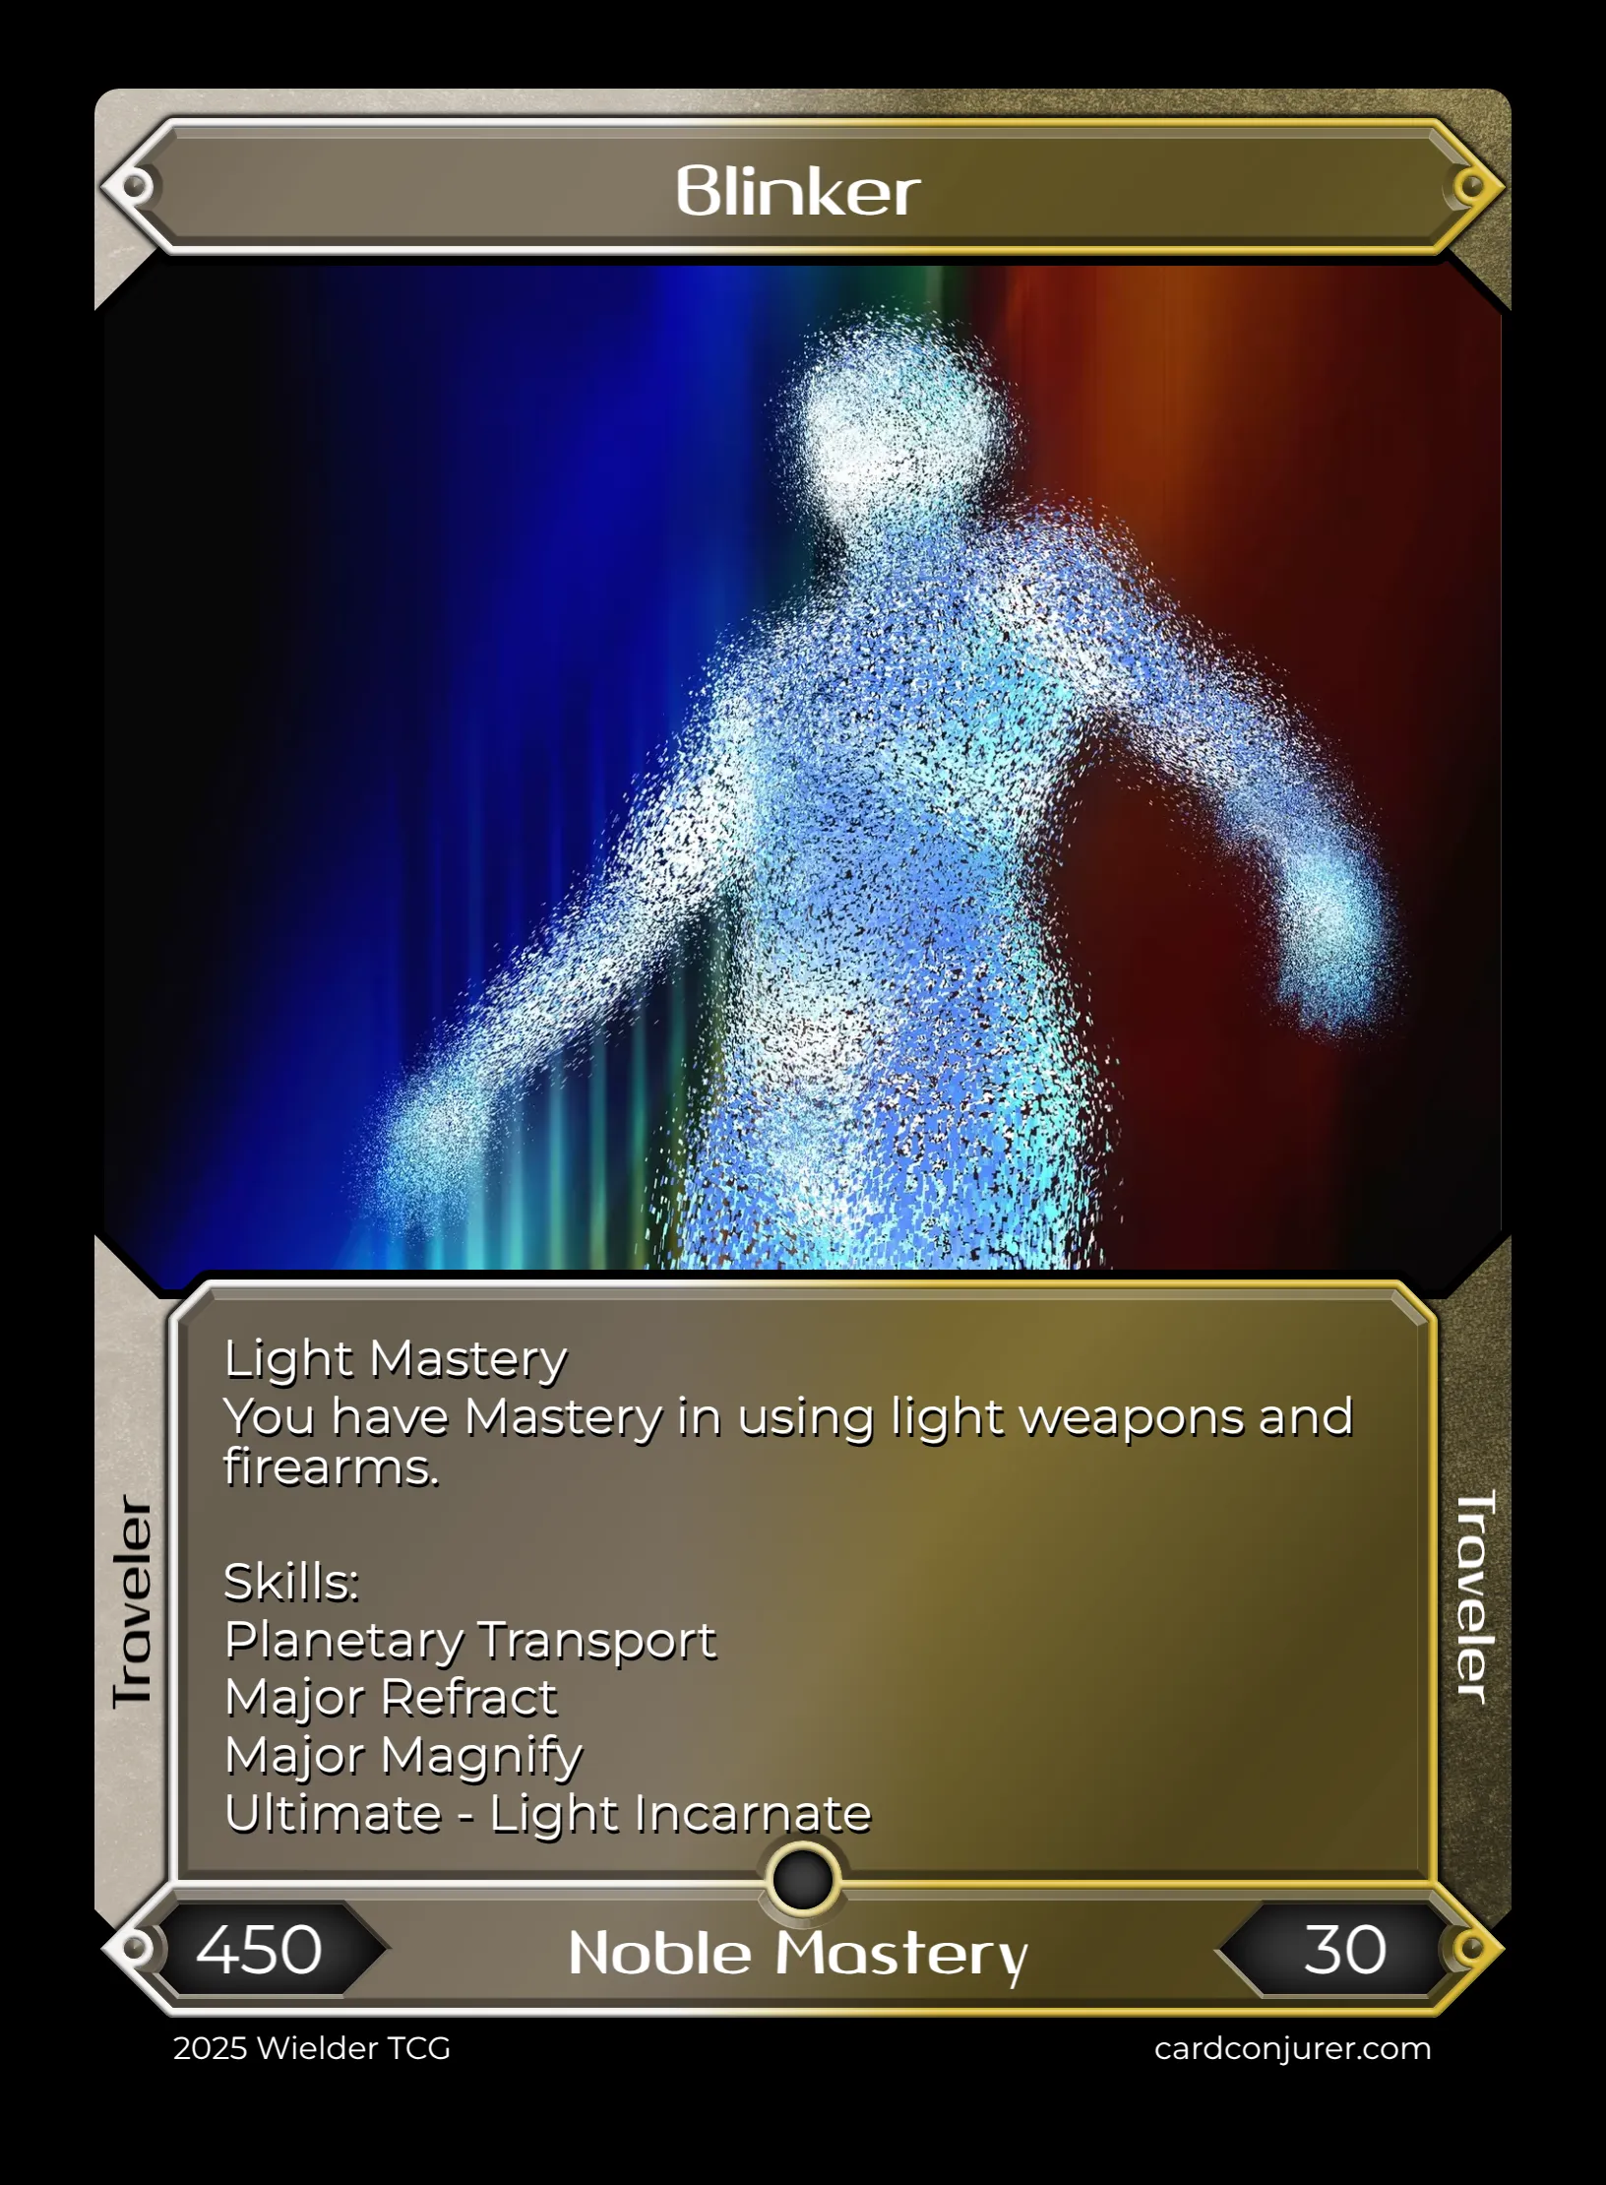
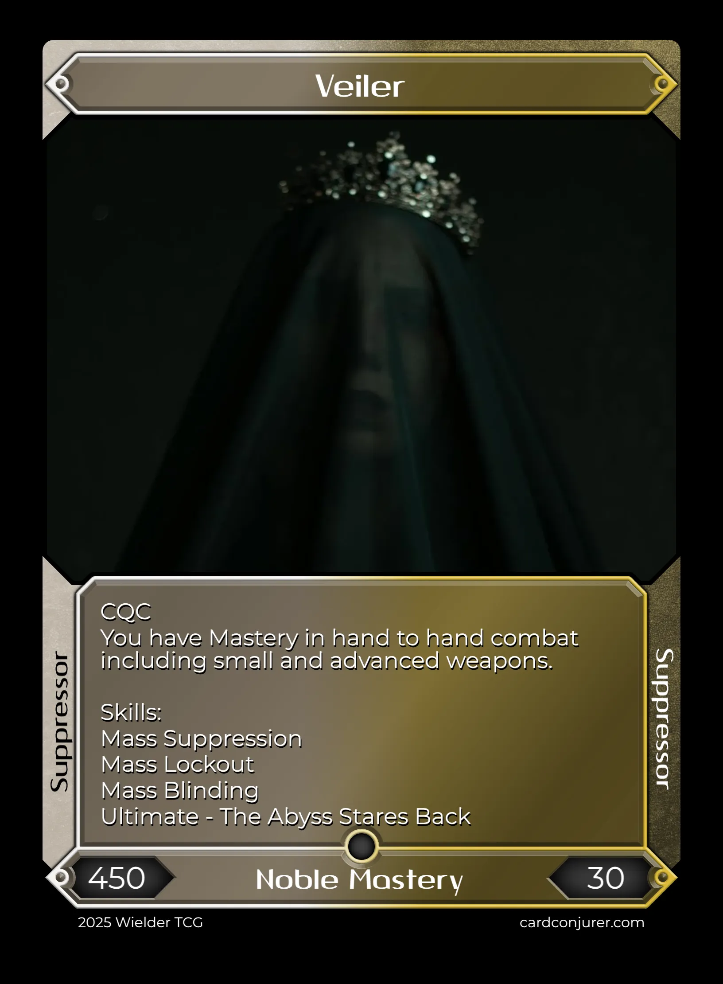
There have been only nine Nobles in history. Will you become the Tenth?

Slide 4
Elevator Pitch
01
Wielders is a universe where thirty powers can be used by anyone in the world.
These Wielders must delve into Fissures, increasing the mastery of their power and finding loot to support them in their journey.
Will you be the last person standing, becoming the Sole Noble?
Or, will you band together and defeat the Nobles in the Final Fissure?
Only Fate may know.
Appease the Monarchs, or bring them down from their thrones.

Slide 5

Unique Selling Points
01
02
03
02
Mastery System
Your power evolves with you. Train to increase your Mastery, raising your stats and unlocking new skills.
Alter Ego Mechanic
Your Alter Ego is you. Activate Alter Ego to gain a completely different power with a different weapon.
Phase System
Wielders has multiple phases. Phase 1 is the Training phase, where minor Fissures spawn. Phase 2 and 3 are middle- and end-game phases.

Slide 6

Target Audience
Audience
03
Target Age
A long, complex game made for strategy. 13+
Strategy, roguelike, card game players.

Slide 7
Gameplay, Genre, Loops
01
02
03
04
05
06
04
Pre-game – choose your initial power, gain its skill cards and corresponding starter weapon
Training – Minor Fissures spawn in your Sector, gain Mastery increase and loot
Grace – the Sector partitions lift up. Players have immunity in their Sector.
Exploration – the Central Sector is revealed, Fissures spawn everywhere
Endgame – Major Fissures spawn, the final Mode is revealed
Apocalypse– Final Fissures spawn. Either Bloodbath or End of the World is selected, fighting each other or a BBEG.

Slide 8
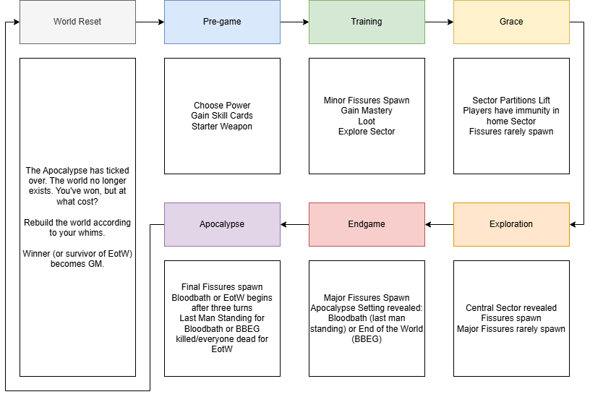
Gameplay, Genre, Loops cont.
04
World Reset occurs after
Apocalypse (game end)
Genre: Modern Fantasy
Feel: Dystopian/Anarchic
Three phases to turn:
Reactions – React to previous turn effects.
Movement – Move around.
Actions – Interact, use skills

Slide 9
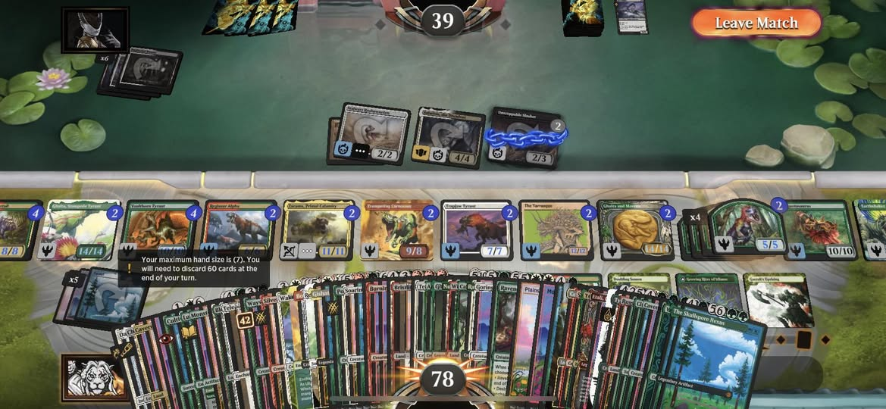
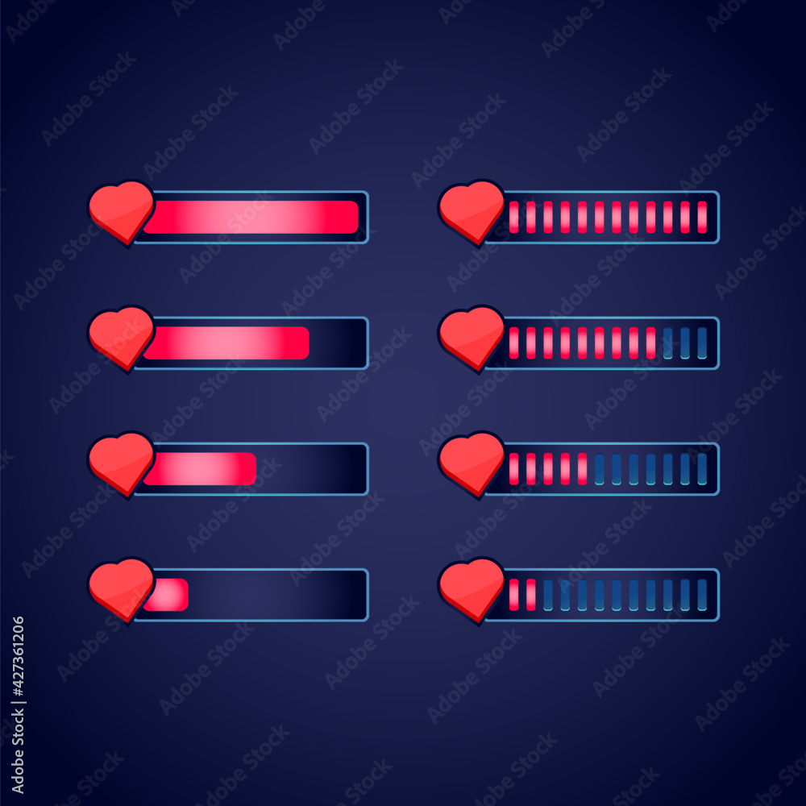
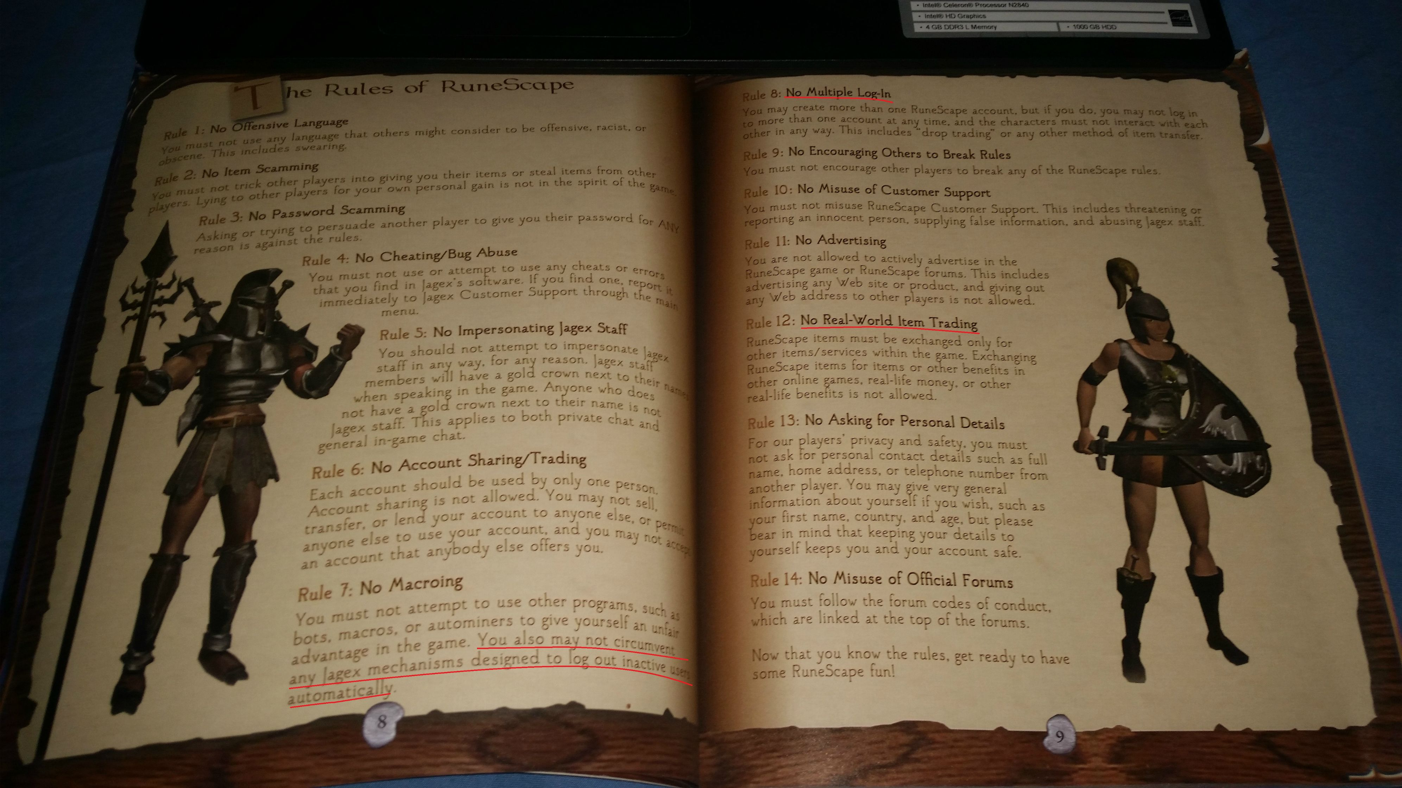
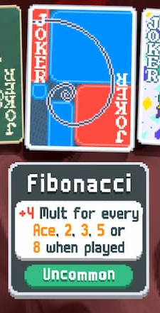
Scope
05
Card drawing mechanic
Score (health) mechanic
Card enlarging and inspection mechanic
Rulebook page
(Bold is crucial items to complete)

Slide 10
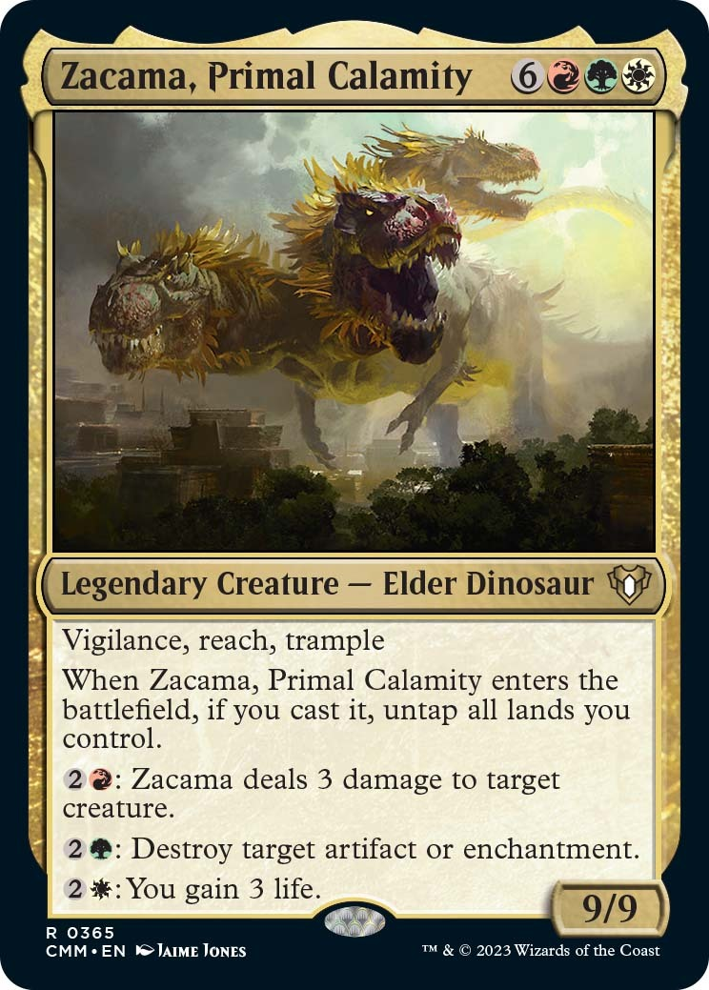
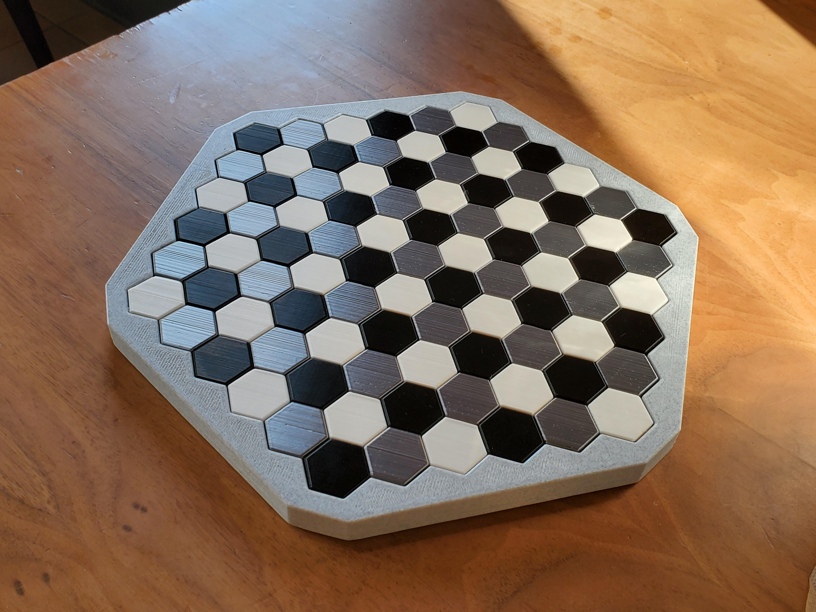
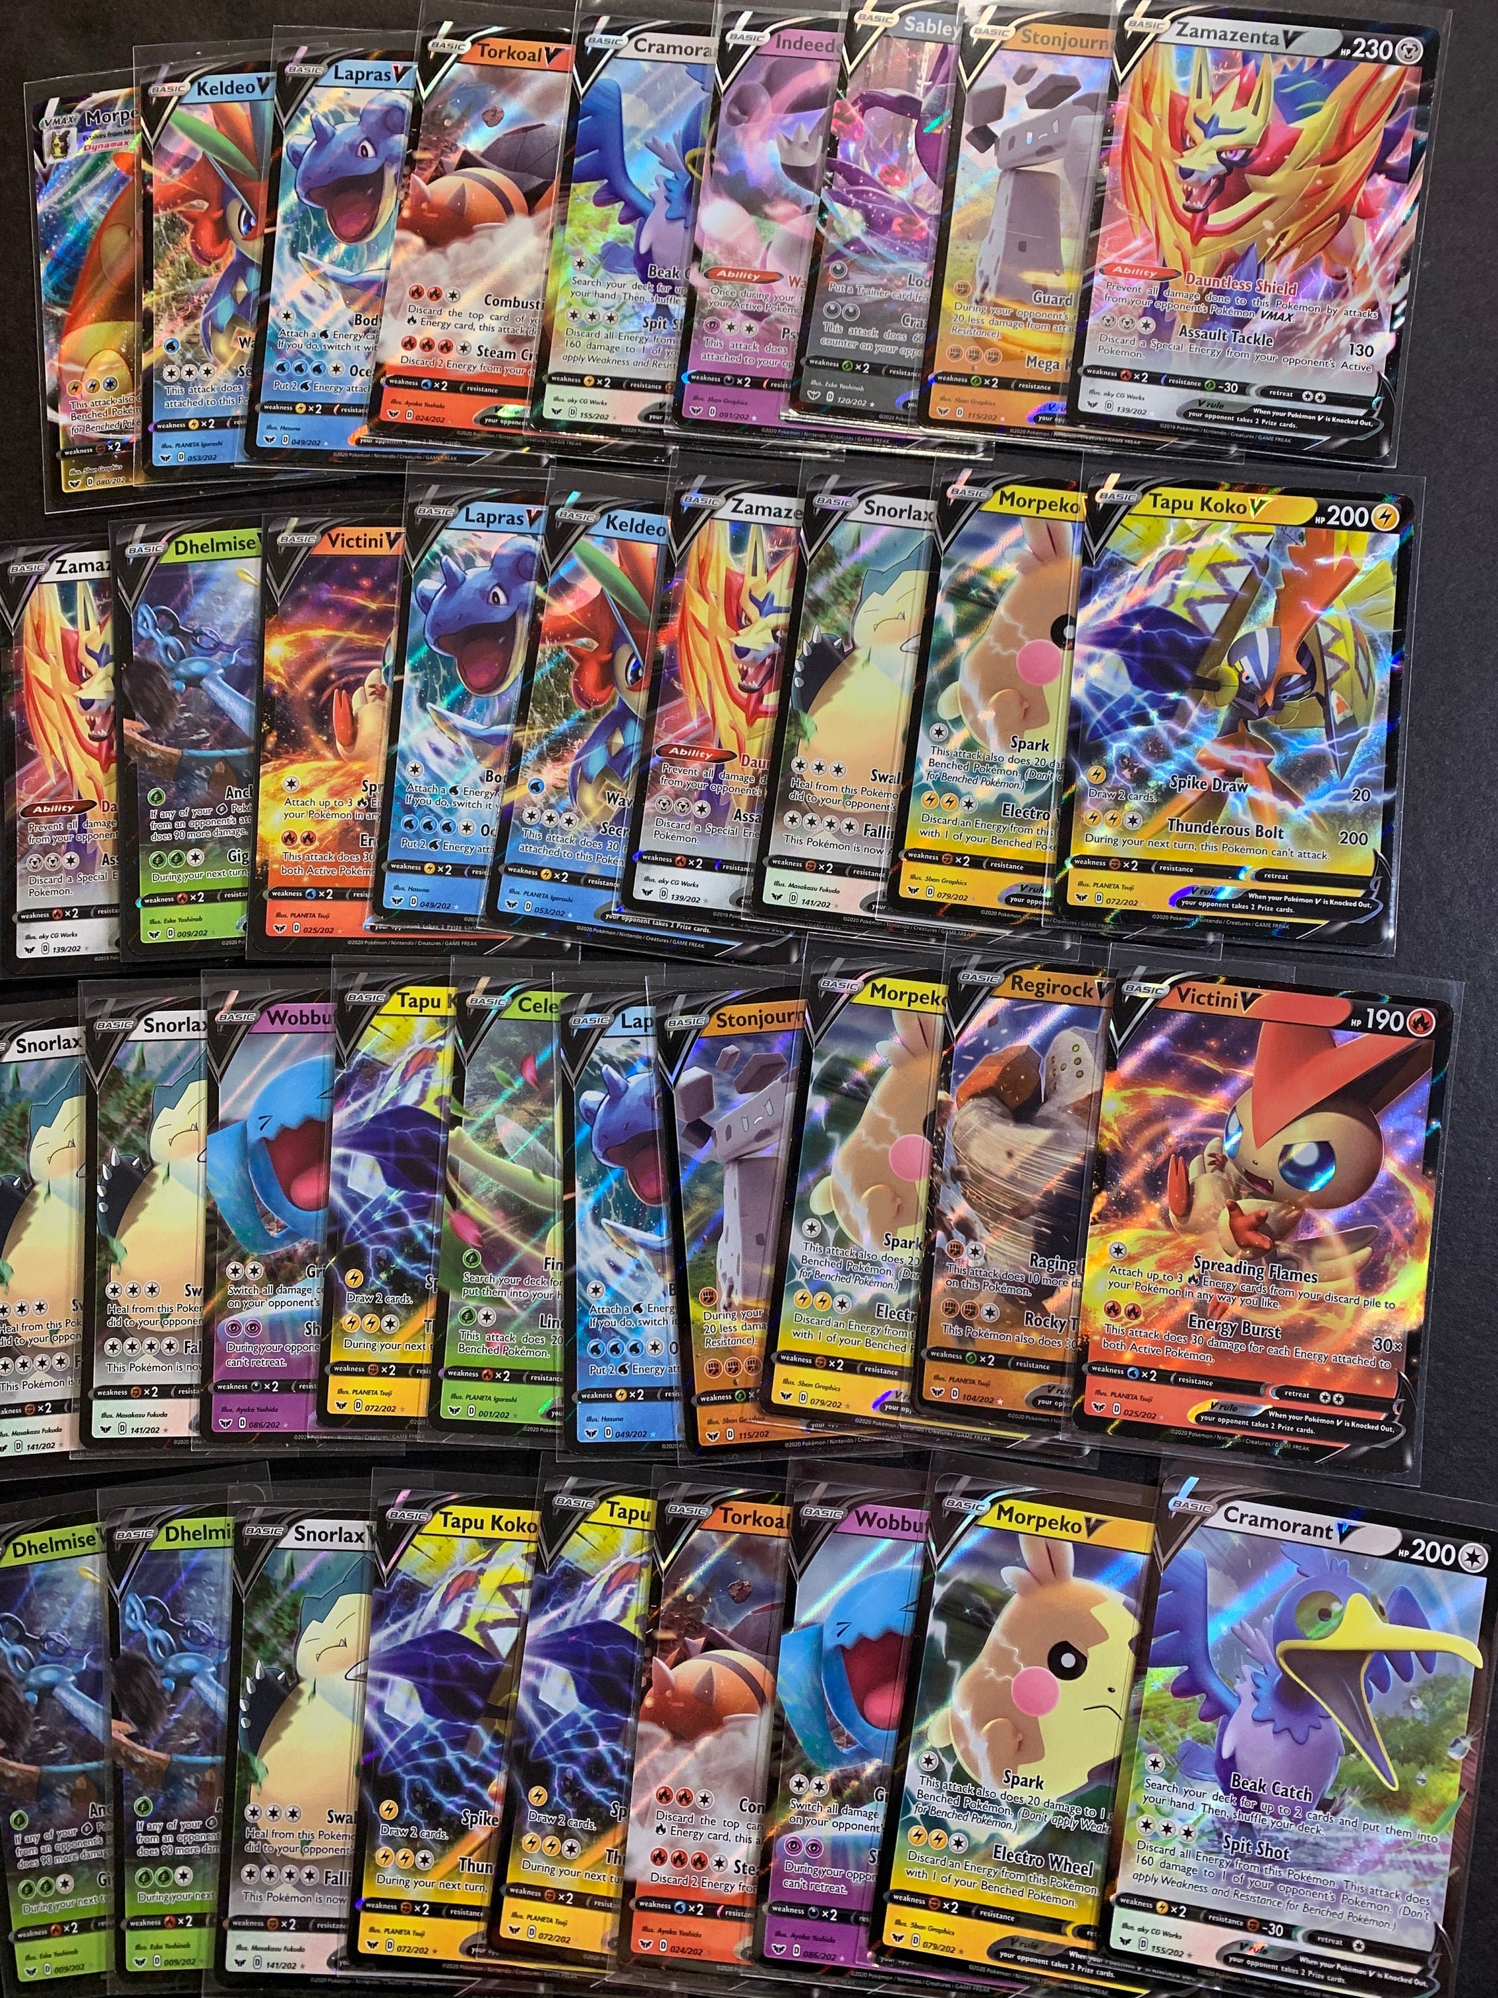
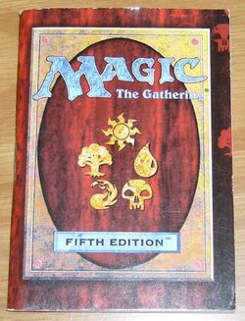
Photos and References

Slide 11
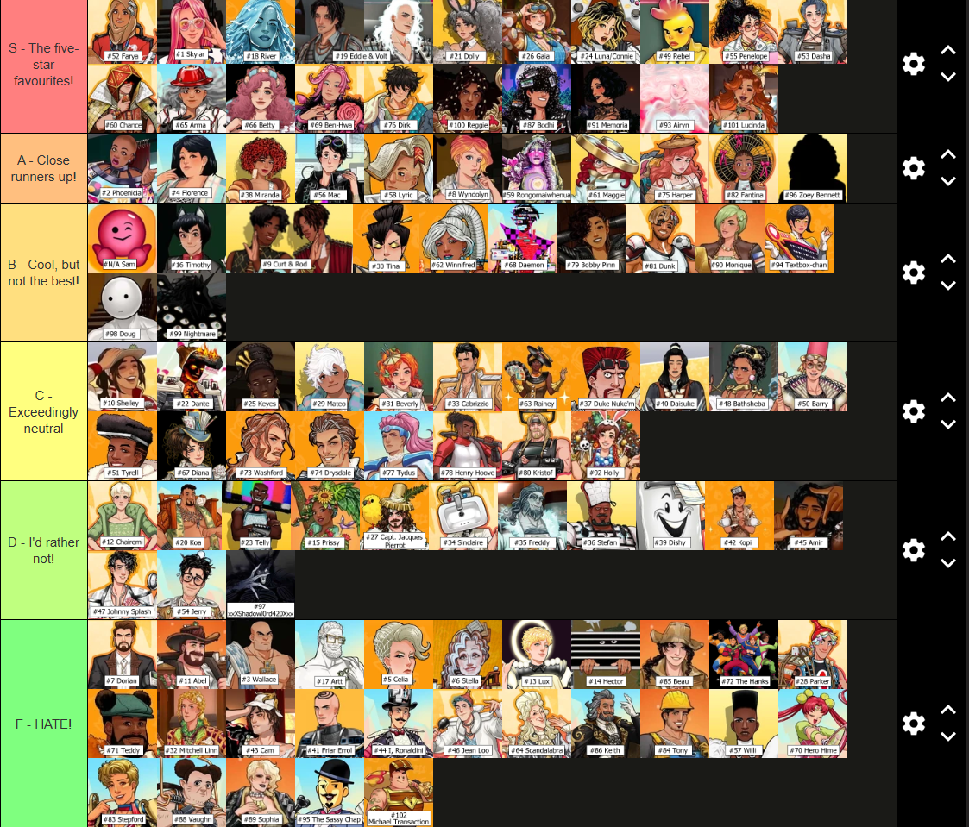
THANK YOU
Do you have any questions?
How to Make a Roguelike Deckbuilding Card Game in Unity | Ep. 1 - Card Data
Please keep this slide for attribution

